Slide 1
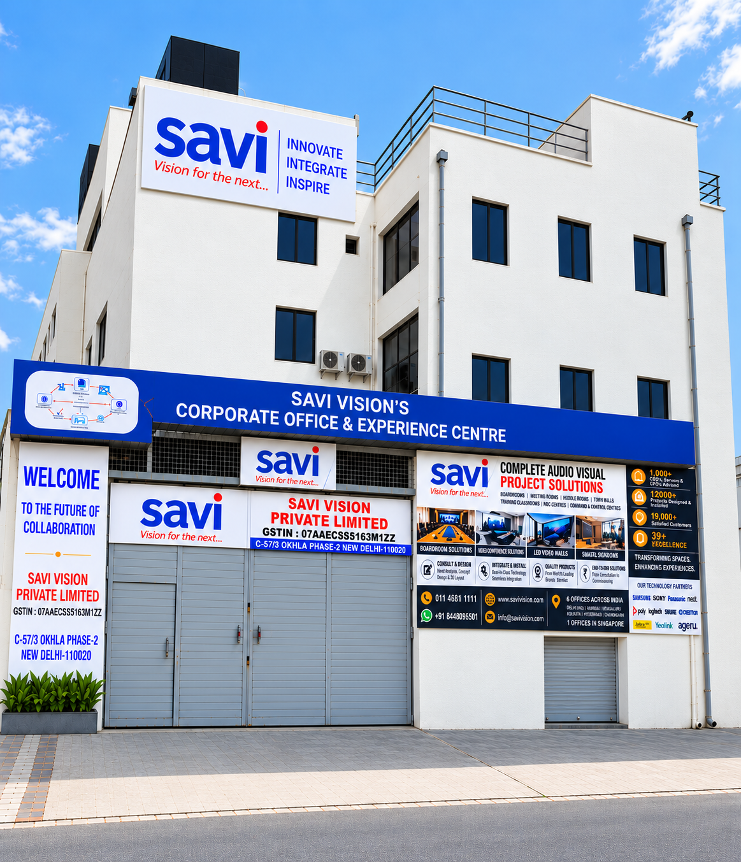


COMPANY PROFILE
Trusted Since 1987.
Engineered for
What's Next.
Boardroom / command centre — dark tone
Enterprise Audio Visual integration, collaboration and automation — designed, installed and supported as one system.
39+
19,000+
12,000+
YEARS
CLIENTS
PROJECTS
Notes:
Open on the two facts that matter: 1987, and what comes next.

Slide 2
— THE COMPANY
Since 1987, we've engineered the infrastructure behind the conversation.
Savi Vision Pvt. Ltd. was founded in 1987 and has grown, under the leadership of Sanjeev Ratra, into a trusted name in audio-visual integration and smart technology — headquartered in Okhla, New Delhi, with projects delivered across India and abroad.
We operate as a single, accountable partner across the entire lifecycle of a space: consultation, system design, professional installation, and after-sales support — so corporate offices, educational institutions, retail environments, and control rooms get technology that's engineered to perform, not just installed.
SAVI VISION PVT. LTD.
02 / 18
Notes:
Founded 1987, incorporated 1998, led by Sanjeev Ratra. One accountable partner across the lifecycle of a space.

Slide 3

— THE COMPANY
Four decades of measurable trust.
39+
19,000+
12,000+
Years of excellence
Customers served
Projects delivered
100+
6
1
Global technology partners
Branches across India
Office in Singapore
SAVI VISION PVT. LTD.
03 / 18
Notes:
Scale slide. Let the numbers sit for a beat.

Slide 4
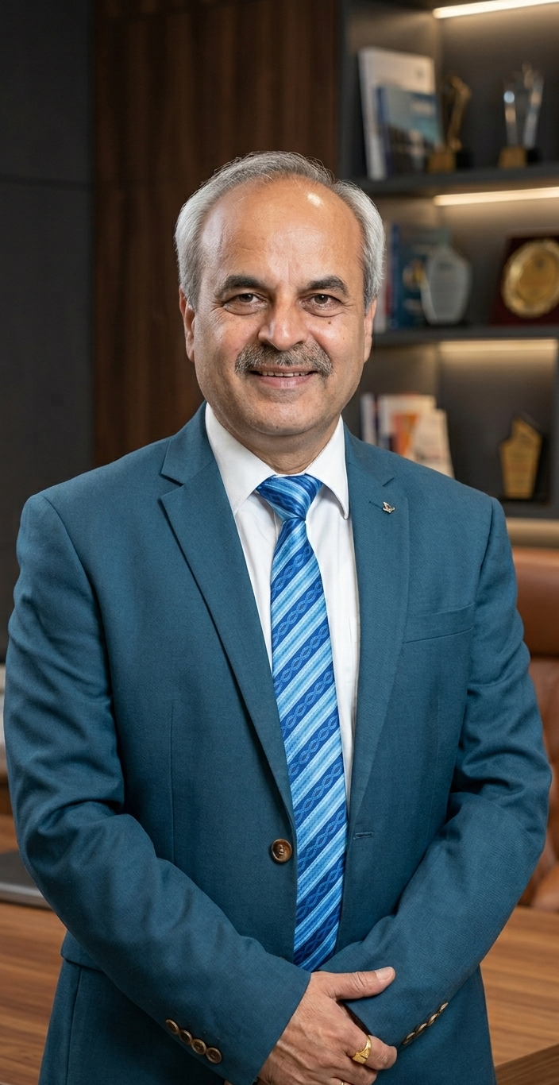
— THE COMPANY
LEADERSHIP
“Under my leadership, Savi Vision has evolved into a trusted provider of modern AV and smart communication solutions — built on a strong foundation of innovation and excellence.
Our journey is guided by four core pillars: Honesty, Transparency, Dedication and World-Class Services.”
Sanjeev Ratra
Founder, Savi Vision Pvt. Ltd.
SAVI VISION PVT. LTD.
04 / 18

Slide 5
— OUR JOURNEY
39+ Years of Innovation
From an AV consultancy in 1987 to an enterprise integration partner today.
1987
1994
2004
2018
2024
Founded by Mr. Sanjeev Ratra as an Audio Visual consulting and services company.
Became Distributor for Plus Corp. Japan Projector
Panasonic Distribution across India
New AV Planet Experience Centre opened at X8 Okhla, Phase 2
Designed and completed 1800+ AV Rooms
New AV showroom opened in GK, in the same building as Mr. Kapil Dev’s office
1992
1998
2008
2020
2026
Launched First TFT Projector
Hitachi Projector and Plasma Panel Launch & Distribution Across India
Start AV Projects
Stopped Distribution and Focus on Projects Only
Savi Owned Worldclass AV Planet Experience Centre at C57/3 Okhla Phase 2, New Delhi-110020
SAVI VISION PVT. LTD.
05 / 18

Slide 6
— WHAT WE DO
Four disciplines. One integrated system.
From the boardroom to the control room, every engagement draws on the same four core capabilities.
01
02
03
04
Workplace & Corporate Collaboration
Video Conferencing Solutions
Large-Format Displays & Signage
Managed Services, Security & AMC
Engineered around how your teams actually work.
Unified communications hardware built for reliability.
Always-on visual environments, centrally managed.
Operational support long after installation day.
Matrix routing & touch control
Unified Communications (UC) kits
Direct-view LED walls, indoor & outdoor
AV consultancy & acoustic blueprints
Cost-efficient huddle spaces
AI-powered PTZ cameras with tracking
Annual Maintenance Contracts (AMC)
Line-array sound for town halls
Signage on Samsung Tizen & LG webOS
CCTV & enterprise security systems
Interactive smart classrooms
Far-field microphone arrays
24/7 monitored support
BYOD wireless casting systems
Multi-screen control rooms
Command centre deployments
SAVI VISION PVT. LTD.
06 / 18
Notes:
Every engagement draws on the same four capabilities. This is the core of what we sell.

Slide 7
— SOLUTIONS
Our core solutions
Engineered environments for every kind of space where your business communicates.
Huddle Room
01
Meeting Room
02
Board Room
03
Compact, ad-hoc spaces engineered for fast, focused conversations between small teams.
Collaborative mid-size rooms with integrated video, audio and content sharing built in.
Executive-grade environments engineered for presentation, negotiation and decision-making.
Town Hall
04
Auditorium
05
Home Theatre
06
Large-scale gathering spaces with line-array sound and high-impact visual systems.
Immersive, large-venue systems built for lectures, ceremonies and public gatherings.
Cinematic-grade audio and display environments, engineered for the home.
07
World-Class Smart Classroom
Modern learning spaces designed with smart displays, clear audio and interactive technology to make teaching more engaging and learning more effective.
SAVI VISION PVT. LTD.
07 / 18

Slide 8

— PRODUCTS
Product portfolio
Enterprise-grade hardware from the world's most trusted AV manufacturers.
Video Conference
Audio System
Display
Unified communications systems built for enterprise-scale collaboration.
Studio-quality sound engineering for rooms of every size.
Precision visual technology for presentation and collaboration.
Poly (HP) · Crestron · Yealink · Neat · Jabra · Logitech
BOSE · JBL · QSC · Crestron · BOSCH
Samsung · Panasonic · LG · Sony · ViewSonic · BenQ
Video Wall
Projector
Automation
Seamless large-format canvases for immersive visual impact.
Cinematic-grade projection for auditoriums and venues.
Intelligent room control systems, engineered for simplicity.
Barco · Absen · Planar · LG · Samsung · Ageru
BenQ · Epson · Panasonic · Sony · ViewSonic
Crestron · Kramer · Milestone · Lightware · Aten
SAVI VISION PVT. LTD.
08 / 18
Notes:
Six categories, and the brands we deploy in each.

Slide 9


















— PARTNERS
Principal partners
We design and deploy with the world's most trusted AV and enterprise technology brands.
Alongside ViewSonic, Kramer, Dahua, Ageru and Huddly — 100+ global technology partners in total.
SAVI VISION PVT. LTD.
09 / 18
Notes:
Principal partners. Drop the official logos into the reserved cells.

Slide 10

























05 — CLIENTS
— CLIENTS
Trusted by India's leading brands
Trusted by India's leading brands
Recognized by 19,000+ clients across Corporate, Healthcare, Transportation, Retail and Public-sector spaces.
Recognized by 19,000+ clients across corporate, healthcare, retail and public-sector spaces.
Reliance Industries
Apollo Hospitals
Mercedes-Benz
Godfrey Philips
Decathlon
Bacardi
Honda
Paytm
Dabur
Airtel
Also delivered for Delhi Metro Rail Corporation, NIIT, CMR University, NorthCap University, CRC Builders, DLF, M3M and SD Biosensor Healthcare.
19,000+ clients served across corporate, education, healthcare, retail and public-sector spaces.
SAVI VISION PVT. LTD.
11 / 19
SAVI VISION PVT. LTD.
10 / 18

Slide 11
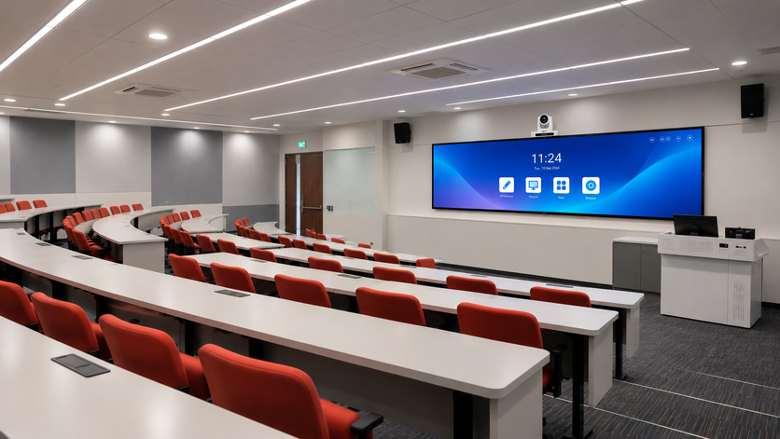
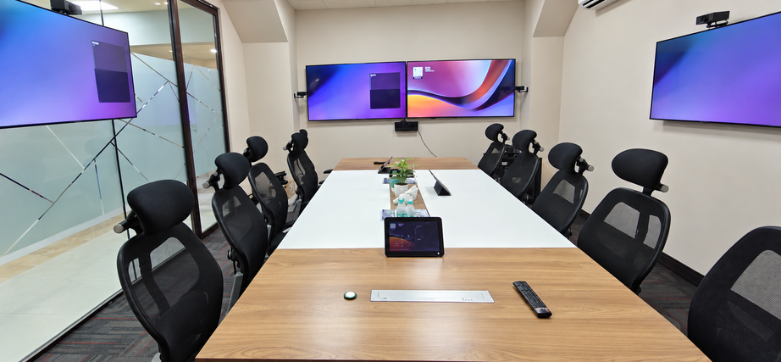
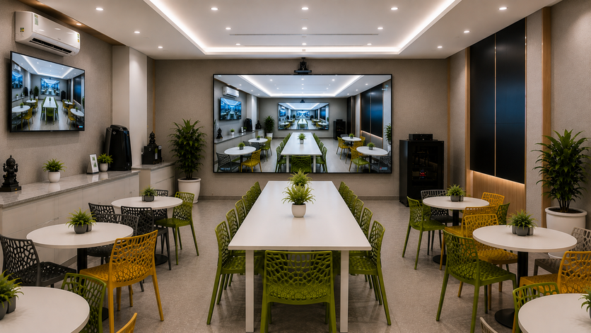
— PROJECTS
Featured projects
A track record built across three distinct kinds of spaces.
Education
Corporate
Reality
Smart classrooms and campus-wide AV infrastructure engineered for modern learning environments.
Boardrooms, conference rooms and enterprise campuses equipped for seamless collaboration.
Immersive, next-generation deployments pushing AV integration into new kinds of experiences.
SAVI VISION PVT. LTD.
11 / 18
Notes:
Three kinds of space. Pick the one that matches the room you're standing in.

Slide 12
— PROJECTS
Selected engagements
Organizations that have trusted Savi Vision with their AV infrastructure.
Delhi Metro Rail Corporation
CMR University
DLF
Godfrey Phillips
NorthCap University
M3M
NIIT
CRC Builders
SD Biosensor Healthcare
12,000+ projects delivered across every industry and room type.
SAVI VISION PVT. LTD.
12 / 18
Notes:
Named organizations from the late 2010s onward. Verified from our own journey record.

Slide 13
— WHY SAVI VISION
Built on four decades of getting it right.
Scale, accountability and technical depth — the reasons enterprises keep choosing Savi Vision.
39+ Years of Proven Expertise
End-to-End Delivery
Proven at Scale
Since 1987, engineering AV systems trusted across corporate, education and public-sector spaces.
One accountable partner from consultation and design through installation and support.
19,000+ clients and 12,000+ projects delivered across every industry and room type.
Global Technology Partnerships
Dedicated AMC & Support
Security-Conscious Integration
Deploying trusted brands including Samsung, Crestron, Poly and Bose.
Structured maintenance contracts engineered to minimize meeting-room downtime.
CCTV and enterprise security considered as part of every deployment.
SAVI VISION PVT. LTD.
13 / 18
Notes:
Six reasons. The through-line is accountability.

Slide 14

— LIFECYCLE
Support that starts after installation day.
Operational lifecycle support keeps systems running long after handover — structured maintenance contracts engineered to minimize meeting-room downtime, with security considered as part of every deployment.
01
02
03
04
AV Consultancy
Professional Installation
Annual Maintenance
Technical Support
Acoustic planning, system design and solution consultation before deployment begins.
In-house engineering teams handle installation, integration and commissioning with precision.
AMC services with preventive maintenance and defined response commitments for reliable performance.
Ongoing remote and on-site technical support to keep AV systems reliable and operational.
SAVI VISION PVT. LTD.
14 / 18
Notes:
The part most integrators skip. Installation day is the beginning, not the deliverable.

Slide 15
07 — RECOGNITION
Recognition earned. Excellence proven.
2023
Best AV Integrator
Recognized by leading industry groups for delivering seamless, large-scale turnkey Audio Visual solutions to top-tier corporate enterprises.
2024
Project Innovation Award
Awarded for pioneering advanced AI-driven workspace architectures and secure command-and-control centre environments.
2025
Sustainable Innovation Award
Honored for leading the transition toward eco-friendly, energy-efficient Audio Visual designs and sustainable smart automation infrastructures.
SAVI VISION PVT. LTD.
15 / 18

Slide 16
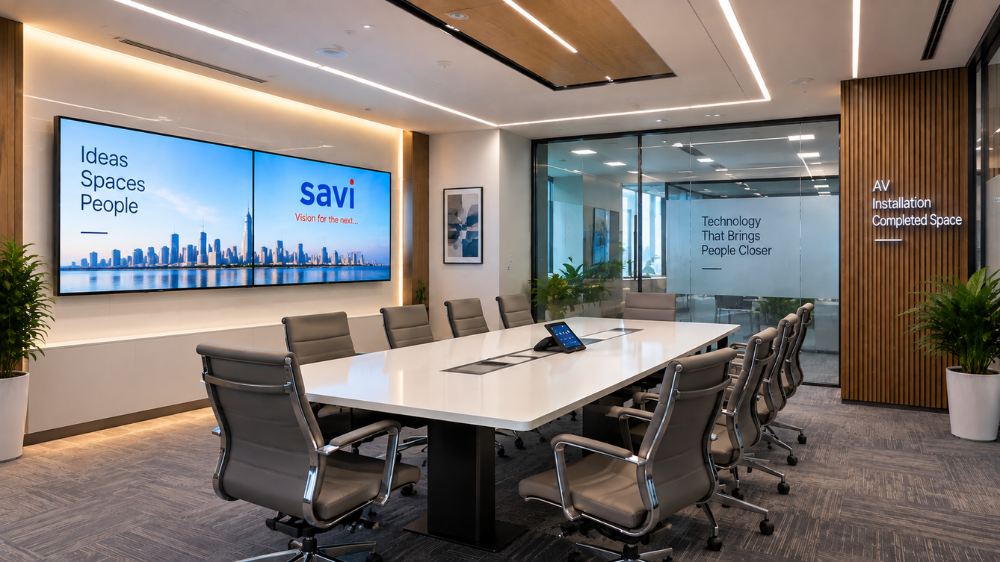
— PRESENCE
A nationwide network, engineered from Delhi.
Headquartered in Okhla Phase-II, New Delhi, with an Experience Centre showcasing interconnected workplace technologies — plus six branches across India and one office in Singapore.
6
1
1
Branches across India
Office in Singapore
Experience Centre, Okhla
SAVI VISION PVT. LTD.
16 / 18
Notes:
Six branches, one Singapore office, HQ in Okhla with the Experience Centre.

Slide 17

CLIENT VOICE
“Savi Vision delivered our boardroom automation on time and exactly to spec — the kind of execution you can build a long-term partnership on.”
MR. Kamleshwar Suri (IT, PI Industry)
SAVI VISION PVT. LTD.
17 / 18
Notes:
Let the quote sit. Don't read it out loud.

Slide 18

Let's engineer your next space.
From first consultation to ongoing support, our team is ready to design the AV infrastructure your business needs.
HEAD OFFICE
TELEPHONE
C-57/3, Tundelkar Ji Road,
Okhla Phase II,
Okhla Industrial Estate,
New Delhi – 110020 ((भारत)
+91 11 46811111
+91 98100 66450
+91 84480 96501
EMAIL & WEB
info@savivision.com
www.savivision.com
ENTERPRISE AV INTEGRATION · EST. 1987
Notes:
Close on the invitation and the address. Hand over a card.

